Slide 1

Smart Contracts & DeFi
Loke KS

Slide 2
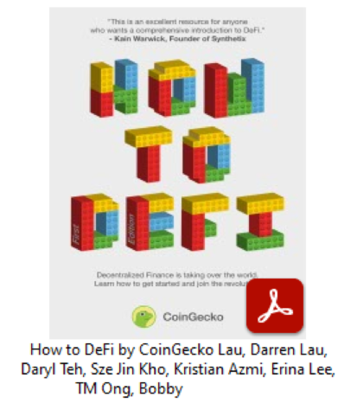
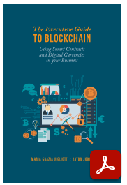
References
Darren Lau et al. How to DeFi, 1st Edition, March 2020.
Vigliotti M.G., Jones H. (2020) Smart Contracts. In: The Executive Guide to Blockchain. Palgrave Macmillan, Cham.
https://link.springer.com/book/10.1007/978-3-030-21107-3#about

Slide 3
Plan
Lectures
15 min quiz
Hands-on DeFi
DeFi-Demo.pdf
DeFi-Aave.pdf

Slide 4
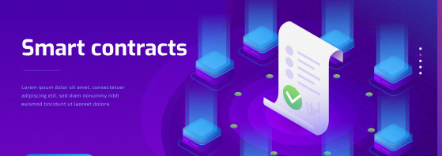
Smart Contracts
A smart contract is a computerised transaction protocol that executes the terms of a contract. - Nick Szabo 1996

Slide 5
Smart Contracts
Contract
– A written or spoken agreement, especially one concerning employment, sales, or tenancy, etc., that is intended to be enforceable by law.
Smart Contract
– A programmable digital agreement that may be self-enforcing or self-executing or both, based on the nature of the agreement and transaction, made directly between involved stakeholders over a blockchain network.
Shilpa Karkeraa, 2020, Unlocking Blockchain on Azure, https://doi.org/10.1007/978-1-4842-5043-3_5

Slide 6
Smart Contracts as Contracts?
Some authors say that smart contracts are actually agreements, written in computer code, a piece of software that executes or enforces some of the terms of the agreement.
Using the word agreement here, rather than contract, is deliberate. A contract is a legally binding agreement, which can be enforced in a court of law.
An agreement, however, is a stipulation of clauses which sets out obligations without being legally binding. All contracts are agreements; not all agreements are contracts.
Some smart contracts can be legally binding, but others will need to be tested in court.

Slide 7
Smart Contracts
The idea behind smart contracts and smart licensing of proprietary material (e.g., software, music and digital art) is that the contractual control of transactions between two or more entities is confirmable programmatically through the blockchain instead of through a central gatekeeper or arbitrator.
Smart contracts eliminate the need for two parties to depend on a central authority because they ‘can agree’ between themselves, define the terms and implications of their agreement programmatically and conditionally, with automatic asset releases when fulfilling services in a sequential manner, or incur penalties if not fulfilled.
V. Morabito, Business Innovation Through Blockchain, Springer. 2019. DOI 10.1007/978-3-319-48478-5_6

Slide 8
Smart Contracts
The definitions imply that smart contracts are computer codes that reside in the blockchain and implement if this then do that, run and are confirmable by a number of computers to ensure truthfulness.
There is no need for a middleman or company sitting in the middle of agreements or transactions and amassing fees with the use of computer code (embedded in a blockchain) to articulate, verify, and enforce an agreement between parties

Slide 9
Smart Contracts
A smart contract on the blockchain is a piece of code that represents the terms of an agreement among parties.
The obligations are enforced via the consensus process when the parties deploy the contract.
A smart contract on the blockchain enables participants to:
Inspect the code to ensure it meets the agreed clauses.
Be reassured that an agreed contract, once registered on the blockchain, is tamperproof.
Be certain the contract executes in the same way for all participants.

Slide 10
Smart Contracts
Smart contract code is located on the blockchain that is recorded on the ledger.
All participants in using the contract will:
Have a copy of the code.
Be able to audit the contract.
Interact with the contract to provide input.
Once registered, a contract on the blockchain cannot be modified.
The Ethereum platform extends Bitcoin by enabling arbitrary code, known as ‘contracts’.

Slide 11
Smart Contracts as Code
The fact that these programs are run on a blockchain makes them dissimilar to other types of software.
First, the program itself is registered on the blockchain, thus having its blockchain’s unique permanence and censorship defiance.
Then, the software can on its own manage blockchain assets, in other words, it can actually store and allocate chunks of cryptocurrency.
Finally, the program is triggered by the blockchain, meaning it will always work as designed and no one can obstruct or change its operation.
To most developers, the term ‘smart contracts’ is often used to refer to this blockchain

Slide 12
Smart Contracts as Code
Bitcoin supported a set of basic instructions called operation codes (opcodes), which form the Bitcoin scripting language that is not Turing-complete.
The Ethereum blockchain enables smart contracts, computer programs that run as decentralized applications (dApps) in a virtual runtime environment called the Ethereum Virtual Machine (EVM).
The EVM is a simulated computer that can execute a set of instructions that are translated into the underlying machine code and then run on the non-virtual computer hardware provided by the miners.

Slide 13
Smart Contracts as Code
Computer programs Smart contracts are simply computer programs. The word “contract” has no legal meaning in this context.
Immutable Once deployed, the code of a smart contract cannot change. Unlike with traditional software, the only way to modify a smart contract is to deploy a new instance.
Deterministic The outcome of the execution of a smart contract is the same for everyone who runs it, given the context of the transaction that initiated its execution and the state of the Ethereum blockchain at the moment of execution.

Slide 14
Smart Contracts as Code
EVM context Smart contracts operate with a very limited execution context. They can access their own state, the context of the transaction that called them, and some information about the most recent blocks.
Decentralized world computer The EVM runs as a local instance on every Ethereum node, but because all instances of the EVM operate on the same initial state and produce the same final state, the system as a whole operates as a single “world computer.”

Slide 15
Example
if Alice wants to set up a trust fund to pay Bob $100 at the start of each month for the next 12 months, she can program a smart contract to:
Check the current date
At the start of each month, send Bob $100 automatically
Repeat until the fund in the smart contract is exhausted
Using a smart contract, Alice has bypassed the need to have a trusted thirdparty intermediary (lawyers, escrow agents etc) to send the trust fund to Bob and made the process transparent to all involved parties.

Slide 16
Example: AXA
In September 2017, the multinational insurance giant AXA introduced a delay repayment scheme covering 80% of flights worldwide, including all EU countries.
Crucially, the scheme uses a smart contract, which makes it easier for passengers to claim for delayed flights, while at the same time minimizing the risk of fraudulent claims
Vigliotti-Jones2020_Chapter_SmartContracts

Slide 17
Example: AXA
When a flight is delayed beyond an agreed time limit, a payout is made within hours without the claimant having to do anything. It’s a win-win: the claimant doesn’t need to waste time filling out endless forms and AXA is protected from bogus claims as only a subscriber to the scheme with a valid claim will be compensated
https://www.youtube.com/watch?v=xJZulZ_-CMI
Vigliotti M.G., Jones H. (2020) Smart Contracts. In: The Executive Guide to Blockchain. Palgrave Macmillan, Cham. https://doi.org/10.1007/978-3-030-21107-3_8

Slide 18
Example: AXA
A new insurance, which is recorded using a smart contract code, can only be added if:
A flight is identified.
The arrival time is clear.
The premium and the indemnity are both agreed.
To sign-up to the scheme, travellers submit their details at https://fizzy.axa;
They subscribe and pay a premium.
A third party data provider has access to the smart contract, and updates the records on the blockchain when a flight is delayed. AXA can chose to comply with its contractual obligation based on the evidence provided by the blockchain.

Slide 19
Example: AXA
‘We decided to discontinue the product Fizzy, which offered direct, automatic compensation to policyholders whose flights were delayed. The first product of Fizzy did not reach its commercial targets, notably because the market had not enough appetite for this product yet and we did not find the right distribution channels so far,’ said a company spokesperson.
The company went on to say that the experience had not put them off the technology, and in fact it had helped them to better understand it.
“Fizzy has always been for us a product developed in a ‘test and learn’ mode, and the result is positive. We have learned a lot from it at different levels”

Slide 20
Example: AXA Learning Experience
Parametric insurance policies that depend on varying external data to meet a threshold that triggers an automated payout.
Payouts are triggered automatically when pre-agreed threshold levels are exceeded. That means the policy is not subject to interpretation or conditions or caveats.
Appraisers, attorneys or other technical specialists are not needed to resolve claim – cost savings
Once a threshold is reached, claims can be paid in days or, at most, weeks that can be triggered automatically
Each policy is customized - payout formula and coverage limits –according to the client’s strategic objectives, risk appetites and budgets.
https://www.artificiallawyer.com/2020/10/08/axa-scraps-fizzy-insurance-smart-contract-but-still-interested-in-the-tech/

Slide 21
DApps
DApps, shorthand for “decentralized applications,” include all applications that are based on smart contracts.
Multiple smart contracts are combined to operate with each other, which would be known as decentralized application (Dapp) in order to fulfill more complex processes and computation.
Dapps are interfaces that interact with the blockchain through the use of smart contracts.
Dapps look and behave like regular web and mobile applications, except that they interact with a blockchain and in different ways.

Slide 22
DApps
Dapps are built on top of decentralized blockchain networks such as Ethereum and usually have the following benefits:
Immutability: Nobody can change any information once it’s on the blockchain. However human error can occur.
Tamper-proof: Smart contracts published onto the blockchain cannot be tampered with without alerting every other participant on the blockchain.
Transparent: Smart contracts powering Dapps are openly auditable.
Availability: As long as the Ethereum network remains active, Dapps built on it will remain active and usable.

Slide 23
Decentralized autonomous organization
A decentralized autonomous organization (DAO) is an organization represented by rules encoded as a computer program that is transparent, controlled by the organization members and not influenced by a central government.
A DAO's financial transaction record and program rules are maintained on a blockchain
It is organized to run without human managerial interactivity, through the smart contracts that execute automatically
The smart contract code formalize the governance rules of a DAO

Slide 24
DAO
DAO provide an operating system for people and institutions that do not know nor trust each other, who might live in different geographical areas, speak different languages, and be subject to different jurisdictions.
Once deployed, a fully decentralized autonomous organization is independent of its creator and cannot be controlled by one single entity, only by majority consensus of the organization ’ s participants.
Algorithmic administration of governance refers to the protocol rules written in machine-readable code - a blockchain protocol or smart contract code

Slide 25
Ethereum : Decentralized Layer
The majority of the DeFi Dapps are currently being built on the Ethereum blockchain.
Ethereum is a global, open-source platform for decentralized applications.
You can think of it as a world computer that cannot be shut down. On Ethereum, software developers can write smart contracts that control digital value through a set of criteria and are accessible anywhere in the world.
Smart contracts that are written by software programmers are the building blocks of these Dapps.
These smart contracts are then deployed to the Ethereum network, where it will run 24/7.
The network will maintain the digital value and keep track of the latest state.

Slide 26

Ether, Gas and Tokens
Ether is the native currency of the Ethereum blockchain.
On Ethereum, all transactions and smart contract executions require a small fee to be paid. This fee is called Gas denoted in gwei which is 0.000000001 Ether.
Ethereum can be used as a platform to create other cryptocurrencies and tokens
Metamask is a non-custodial wallet and it acts as both a wallet and an interaction bridge for the Ethereum network.

Slide 27

DeFi
DeFi, standing for decentralized finance, is a rapidly growing alternative to the traditional financial world.
The term 'DeFi' was first coined in 2018. It referred to the financial use cases that were beginning to emerge on Ethereum.
Compared to traditional finance, DeFi removes the middlemen, increasing the potential of better returns and lower barriers to entry.
It's largely automated, censorship resistant and accessible to anyone with an internet connection.
It's also transparent and can give you provable ownership of your own assets - letting you 'be your own bank'.
https://blog.makerdao.com/a-brief-history-of-decentralized-finance-defi/

Slide 28
DeFi
“An ecosystem comprised of applications built on top of public distributed ledgers, for the facilitation of permissionless financial services.”
DeFi is an ambitious attempt to decentralize core traditional financial use cases like trading, lending, investment, wealth management, payment and insurance on the blockchain.
DeFi is based on Decentralized Applications (dApps) or protocols

Slide 29
DeFi
Decentralized Finance, better known as DeFi, is predicated on the tenants of non-custodial, trustless and secure systems with 100% uptime. This means:
Companies do not store funds on behalf of their users
Issuing entities are not needed to process transactions
Products are highly secure (thanks to protocols like Ethereum)
24/7 accessibility from anywhere in the world.
https://ethereumprice.org/guides/article/compound-finance-explained/

Slide 30
Centralized & Semi-Decentralized
Centralized
Characteristics: Custodial, uses centralized price feeds, centrally determined interest rates, centrally-provided liquidity for margin calls
Examples: Salt, BlockFi, Nexo and Celsius
Semi-Decentralized
Characteristics: Non-custodial, decentralized price feeds, permissionless initiation of margin calls, permissionless margin liquidity, decentralized interest rate determination, decentralized platform development/updates
Examples: Compound, MakerDAO, dYdX, bZx
Completely Decentralized
Characteristics: Every component is decentralized
Examples: No DeFi protocol is completely decentralized yet
https://hackernoon.com/how-decentralized-is-defi-a-framework-for-classifying-lending-protocols-90981f2c007f

Slide 31
Categories of DeFi
Decentralized stablecoins
Decentralized lending and borrowing
Decentralized exchanges
Derivatives contracts
Fund management
Lottery (tontine?)
Payments Streaming
Insurance

Slide 32
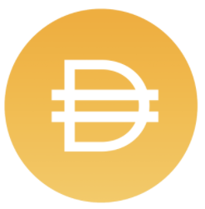
Decentralized Stablecoins
Stablecoins that are pegged to other stable assets such as the USD were created. Stablecoins help users to hedge against this price volatility and was created to be a reliable medium of exchange
Example are two USD stablecoins, Tether (USDT) and Dai (DAI) 貸
Tether pegs itself to $1 by maintaining reserves of $1 per Tether token minted. Tether require a trusted custodian.
Dai on the other hand, is collateralized using cryptocurrencies such as Ethereum. Its value is pegged to $1 through protocols.
DAI is a decentralized, crypto-collateralized stablecoin.
DAI is the native stablecoin used most widely in the DeFi ecosystem. It is the preferred USD stablecoin used in DeFi trading, lending and more.

Slide 33

Decentralized Stablecoins: DAI
The Maker DAO through its MKR tokens control the DAI via the Maker Protocol. MakerDAO is like a credit facility that issues loans with a certain interest rate.
Users generate Dai by depositing collateral assets into Maker Vaults within the Maker Protocol. This is how Dai is entered into circulation and how users gain access to liquidity
Once generated, bought, or received, Dai can be used in the same manner as any other cryptocurrency
All accepted collateral assets can be leveraged to generate Dai in the Maker Protocol through smart contracts called Maker Vaults.
https://makerdao.com/en/

Slide 34

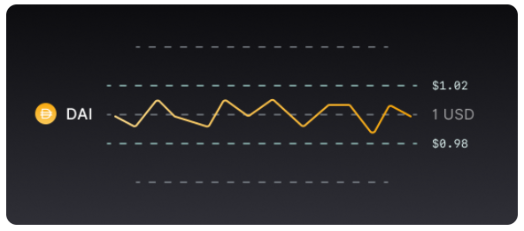
Decentralized Stablecoins: DAI
Use Dai as a payment method, trade Dai exchanges
Earn the Dai Savings Rate (DSR) on Dai held
Lock their ETH in a Maker Vault, generate Dai, and then buy more ETH, hoping that it will increase in price.
Dai can be used for repayment of debt, cross-border transactions, and payment for goods and services. Users can transfer Dai peer-to-peer across the globe within seconds and at a fraction of the cost of traditional means (users only pay a gas fee).
https://oasis.app/dai

Slide 35

Decentralized Lending and Borrowing
In the DeFi landscape, anyone can have access to capital to do whatever they want. Capital lending is also something that is no longer enjoyed only by the wealthy.
Compound Finance is an algorithmic Ethereum-based open-source money market protocol where anyone can supply or borrow cryptocurrencies frictionlessly.
Compound is a DeFi platform, it does not have to follow the Federal Funds Rate. It can do something completely different and cannot be shut down since there is no central authority.

Slide 36

Compound Finance
Compound operates similar to a bank. You can deposit various cryptocurrencies and earn an annual interest on your deposits, similar to depositing your money into the bank.
However, Compound’s main difference is that it does not have custody of your cryptocurrency deposits.
Instead, you are actually sending your crypto to and interact with a smart contract, rather than another company or user. This feature is important because it means that no person or authority can control or take your funds.
Compound operates as a liquidity pool that is built on the Ethereum blockchain. Suppliers supply assets to the pool and earn interest, while borrowers take a loan from the pool and pay interest on their debt.

Slide 37
Note on CDP
Decentralized lending protocols (also: stablecoins and synthetics) uses a mechanism called Collateralized Debt Positions (CDPs.) All DeFi loans today are collateralized.
Similar to how you may need to put your house as collateral to borrow at a bank, you need to deposit some cryptoassets to borrow another.
Collateral are required because blockchain addresses are pseudonymous with no associated real-world identity and no credit scores are available.

Slide 38
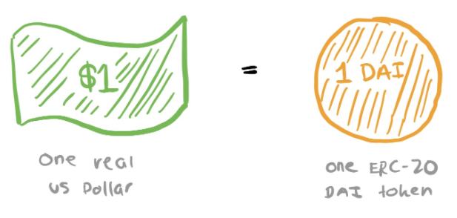
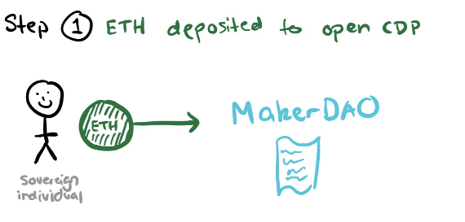
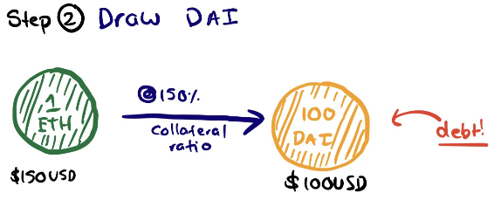
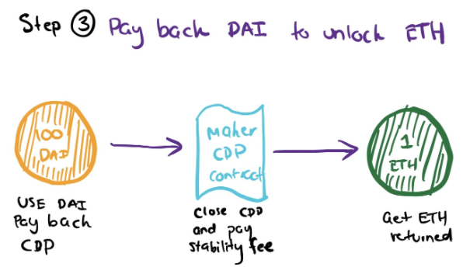
Decentralized Stablecoins: DAI
Collateralised Debt Position (CDP).
https://hackernoon.com/whats-makerdao-and-what-s-going-on-with-it-explained-with-pictures-f7ebf774e9c2

Slide 39
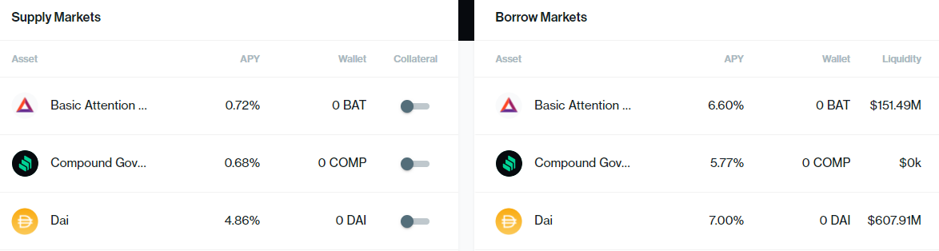
Compound Finance
Using the DAI stablecoin as an example, a lender would earn 4.68% in a year while a borrower would be paying 7.00% interest after a year.

Slide 40
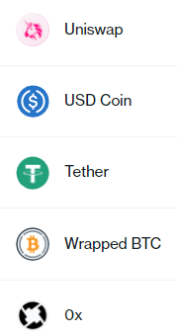
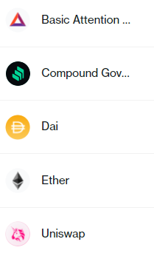
Compound Finance
Users not need to register for an account and that’s the beauty of Decentralized Finance applications!
Once you have deposited your asset into Compound, you will immediately begin to earn interest on the assets you have put in.
Interest in cTokens are accrued on the amount that you have supplied and is calculated after each Ethereum block
Accept 10 tokens currently

Slide 41
Compound Finance Walkthrough
You can earn interest when you deposit (Compound refers to this as “supply”) cryptocurrencies onto their platform.
To do this, first load an Ethereum account with any of the cryptocurrencies supported by Compound.
Then on the Dashboard, choose which cryptocurrency you wish to supply to the platform by clicking on it.
Input the amount you wish to supply and confirm by clicking “SUPPLY”.
A Metamask window will pop up where you will interact with the smart contract and confirm the transaction. You will be charged gas fees for interacting with the smart contract.

Slide 42
Compound Finance Walkthrough
Once you have supplied cryptocurrencies onto the platform, you would be able to use Compound’s other features such as using these supplied cryptocurrencies as collateral to take out loans.
You can use your deposited cryptocurrencies as collateral to borrow other cryptocurrencies. Compound requires users to put up 150% of the value of your intended loan.
Borrowing cryptocurrencies does also require you to pay fees.

Slide 43
Compound Finance COMP Token
Users earn COMP when they supply or borrow cryptocurrencies on the platform.
While you may own interest for borrowing cryptocurrencies, you may earn on the COMP token as its price may appreciate.
If this is the case, then you are being PAID to take out a loan.

Slide 44
Decentralized Exchanges (DEX)
While Centralized Exchanges (CEXs) allow for large trades to happen with plenty of liquidity, it still carries a lot of risks because users do not have ownership of their assets in exchanges.
In 2019, over $290 million worth of cryptocurrencies were stolen and over 500,000 login information were leaked from exchanges.
DEXs work by using smart contracts and on-chain transactions to reduce or eliminate the need for an intermediary.
Some popular Decentralized Exchanges include projects like Kyber Network, Uniswap, Dex Blue and dYdX.

Slide 45

Order book-based DEXs
Order book DEXs like dYdX and dex.blue operate similarly to CEXs where users can place buy and sell orders at either their chosen limit prices or at market prices.
The main difference between the two is that for CEXs, assets for the trade would be held on the exchange wallet whereas for DEXs, assets for trade can be held on users’ own wallets

Slide 46

Liquidity pools-based DEXs
Users may have to wait a long time for their orders to be filled in the order book DEXs.
Liquidity pools are essentially reserves of tokens in smart contracts and users can buy or sell tokens instantly from the available tokens in the liquidity pool.
The price of the token is determined algorithmically and increases for large trades.
Examples of liquidity pools-based DEXs are Kyber Network, Bancor, and Uniswap.
Any ERC-20 token can be listed on Uniswap by anyone and be traded as long as liquidity exists for the given pair
https://uniswap.org/

Slide 47
Decentralized Derivatives
A derivative is a contract whose value is derived from another underlying asset such as stocks, commodities, currencies, indexes, bonds, or interest rates.
There are several types of derivatives such as futures, options, and swaps.
Synthetix is exactly as the name sounds, a protocol for Synthetic Assets (called Synths) on Ethereum.
https://medium.com/bollinger-investment-group/synthetic-assets-in-defi-use-cases-opportunities-19b11f57a776

Slide 48

Synthetix
Synths are assets or a mixture of assets that have the same value or effect as another asset. Synths track the value of underlying assets and allow exposure to the assets without the need to hold the actual asset.
An example of a Synthetic Asset is Synthetic Gold (sXAU) which tracks the price performance of gold.
Compared to traditional gold brokerages, Synthetic Gold (sXAU) allows traders to participate in the market with much less hassle (no sign-ups, no traveling, no middleman etc.).
https://docs.synthetix.io/litepaper

Slide 49
Decentralized Fund Management
Fund management is the process of overseeing your assets and managing its cash flow to generate a return on your investments.
In DeFi, fund management is conducted in a manner where it removes the investment manager and lets you choose the asset management strategy that best suits your financial need.
The Dapp will have algorithms to conduct trades for you automatically instead of doing it yourself

Slide 50

TokenSets
TokenSets is a platform that allows crypto users to buy Strategy Enabled Tokens (SET).
These tokens have automated asset management strategies that allow you to easily manage your cryptocurrency portfolio without the need to manually execute the trading strategy.
Robo Sets are algorithmic trading strategies that buys and sells tokens based on predefined rules encoded in smart contracts.
Social Trading Sets enable users to follow top trading strategies by some featured traders on TokenSets. By buying this Social Trading Set, you can copy the trades performed by these featured traders automatically
https://www.tokensets.com/

Slide 51

Decentralized Lottery
PoolTogether is a decentralized no-loss lottery or decentralized prize savings application where users get to keep their initial deposit amount after the lottery prize is drawn.
Instead of funding the prize money using the lottery tickets purchased, the prize money is funded using the interest earned on Compound by the pooled user deposits.
For each round of PoolTogether, all the user deposits will be sent to Compound to earn an interest and one lucky winner will be selected at random at the end of each interval to win the entire interest prize money.

Slide 52

Payment Streaming
Payment streaming meaning that it allows payment and withdrawals to be made in real time and in small increments (by the second!) between different parties.
Think about payments for hourly consultation work, daily contract workers or monthly rent payment made in real time as work/progress is being made
Instead of having to wait for a fixed period of time (eg. monthly, bi-weekly) for pay, payments are sent in real time in periods defined and agreed upon by both parties.

Slide 53

Decentralized Insurance
Nexus Mutual is a decentralized insurance protocol built on Ethereum that currently offers cover on any unintended smart contract use on the Ethereum blockchain.
Claims assessment can be done entirely remotely using publicly available data from block explorers.
A fixed cover amount means claims assessment is a simple “yes” or “no” rather than requiring an assessment of how much damage has been caused.
The product pricing can be largely automated allowing covers to be issued without any mandatory manual underwriting
https://nexusmutual.io/assets/docs/nmx_white_paperv2_3.pdf
https://nexusmutual.gitbook.io/docs/welcome/faq

Slide 54
DeFi
DeFi can allow us to achieve:
Transparency: A transparent, auditable financial ecosystem.
Accessibility: Free access to DeFi applications without fear of discrimination on race, gender, beliefs, nationality or geographical status.
Efficiency: Programmable money makes it possible to remove the centralized middlemen to create a more affordable and efficient financial market.
Convenience: Money can now be sent anywhere, anytime and to anyone who has access to a cryptocurrency wallet for a small fee and with little waiting

Slide 55
